Slide 1
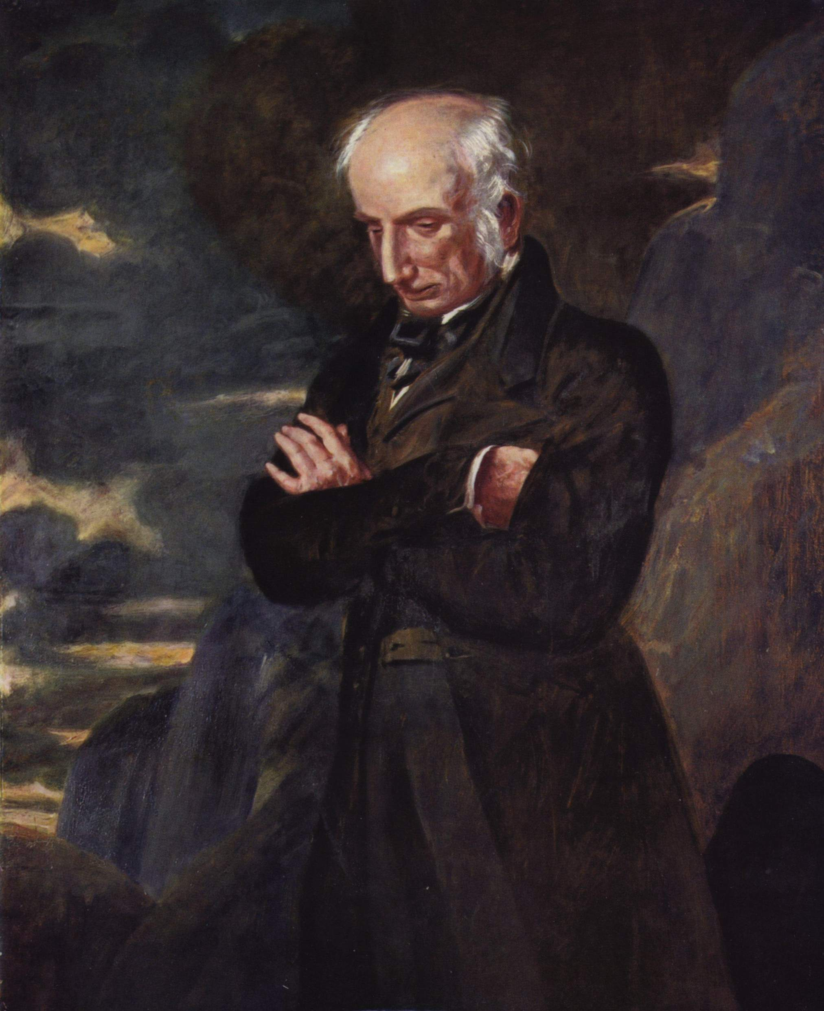

Slide 2
William Wordsworth
Early life and education
A vigorous, unruly, and sometimes moody boy, William spent his free days and occasionally "half the night" in the sports and rambles described in the first two books of The Prelude, "drinking in" (to use one of his favorite metaphors) the natural sights and sounds, and getting to know the cottagers, shepherds, and solitary wanderers who moved through his imagination into his later poetry.
Studied at Cambridge University
Went to France and supported the French Revolution
Married there and had a child but separated later
His work The Prelude is an autobiographical work that issued these values.
Started living with his sister and also poetic career with Coleridge in the Lake District, Grasmere.

Slide 3
Wordsworth's ideas concerning nature , the task of the poet and the nature of poetical composition have become a landmark in the history of English literature and his earlier verse is among the finest of Romantic period.
Wordsworth is extremely versatile and he was accomplished in a number of verse forms, ranging from blank verse, sonnets and odes to ballads and delightfully simple lyrics.
He is frequently thought of as a 'nature poet' : his pantheistic philosophy led him to belive that men should enter into communion with nature.
Wordsworth outlined his main principles concerning poetry in a long preface-hailed by some critics as the manifesto of the English Romantic movement – which he added to the second edition of the Lyrical Ballads in 1800.

Slide 4
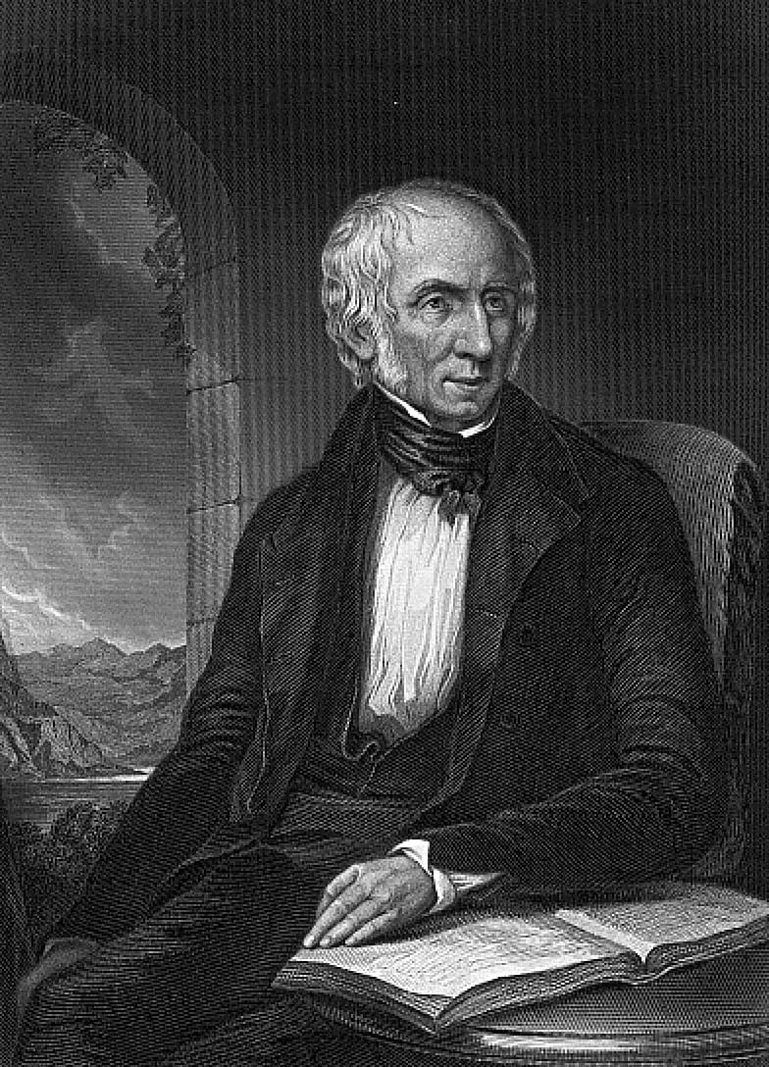
In conjunction with his friend and literary companion, Coleridge , published the highly polemical yet influential collection of poetry Lyrical Ballads (1798)
In the Lyrical Ballads which is the actual declaration of Romanticism, Wordsworth expresses the love of nature.
Additions to the Lyrical Ballads in 1799 were followed by the first draft of his lengthy autobiographical poem, The Prelude , six years later.

Slide 5






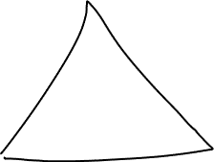



Lyrical Ballads
In his “ Preface to Lyrical Ballads" which is called the "manifesto" of English Romantic criticism, Wordsworth calls his poems "experimental»
He examplified the principles of all good poetry.
«Poetry is the breath and finer spirit of all knowledge...Poetry is the first and last of all knowledge—it is as immortal as the heart of man»
His preface implicitly denies the hiararchical structure in the poetic genres

Slide 6
The main points are as follows:
The language of poetry was to consist of “a selection of language really used by man” . In bringing his language closer to the everyday language of men, 'poetic diction'- with his artful figures of speech and elevated tone – was to be avoided as much as possible.
The subject of poetry was to consist of “incidents and situations from common life”.
«Ordinary things should be presented to the mind in an unusual way.»

Slide 7





Low and rustic life was generally chosen, because in that condition, the essential passions of the heart find a better soil in which they can attain their maturity, are less under restraint, and speak a plainer and more emphatic language; because in that condition of life our elementary feelings co-exist in a state of greater simplicity, and, consequently, may be more accurately contemplated, and more forcibly communicated; because the manners of rural life germinate from those elementary feelings; and, from the necessary character of rural occupations, are more easily comprehended; and are more durable; and lastly, because in that condition the passions of men are incorporated with the beautiful and permanent forms of nature"

Slide 8
“ all good poetry is the spontananeous overflow of powerful feelings” is clearly radical in its implications, but it should not be misunderstood as favouring the unrestained outouring of emotions.
It takes its origing from «emotion recollected in tranquility»

Slide 9
Wordsworth attached great importance to the imagination.
For Wordsworth the memory was a key element in poetic composition.
Poetry results from the active relationship of present to past experience.
Object- poet- sensory experience- emotion-memory- recollection in tranquility- kindred emotion

Slide 10
The concept of a poet
He is a man speaking to men: a man endued with more lovely sensibility, more enthusiasm and tenderness, who has a greater knowledge of human natüre, and a more comprehensive soul
He is talented in the immadiate act of composition
He has artistic independence
Prophetic rather than by labor and study
Deep feeling

Slide 11




I wandered lonely as a Cloud
I wandered lonely as a Cloud
That floats on high o’er Vales and Hills,
When all at once I saw a crowd,
A host of golden Daffodils;
Beside the Lake, beneath the trees,
Fluttering and dancing in the breeze.
Continuous as the stars that shine
And twinkle on the Milky Way,
They stretched in never-ending line
Along the margin of a bay:
Ten thousand saw I at a glance,
Tossing their heads in sprightly dance.

Slide 12
The waves beside them danced, but they
Out-did the sparkling waves in glee:—
A Poet could not but be gay
In such a jocund company:
I gazed—and gazed—but little thought
What wealth the shew to me had brought:
For oft when on my couch I lie
In vacant or in pensive mood,
They flash upon that inward eye
Which is the bliss of solitude,
And then my heart with pleasure fills,
And dances with the Daffodils.

Slide 13
Ode
Intimations of Immortality from Recollections of Early Childhood
The Child is Father of the Man;
And I could wish my days to be
Bound each to each by natural piety

